Slide 1


B.M.S COLLEGE OF ENGINEERING
Basavanagudi, Bangalore - 560 019, Karnataka, India
DEPARTMENT OF ELECTRONICS & OMMUNICATION
PROJECT PRESENTATION ON
“PRECISION AGRICULTURE”
Project By:
1. Hemantha Gowda C.V. - 1BM11EC406 3. NIKHILESH.R - 1BM09IT017
2. KIRAN.M - 1BM09IT014 4. S.M.SALMAN - 1BM09IT025

Slide 2

HISTORY
Agriculture being the Indian economy's strong-hold unfortunately suffers for the carelessness of its cultivators. Its high time we realized our responsibilities & worked towards the upliftment of the society.

Slide 3
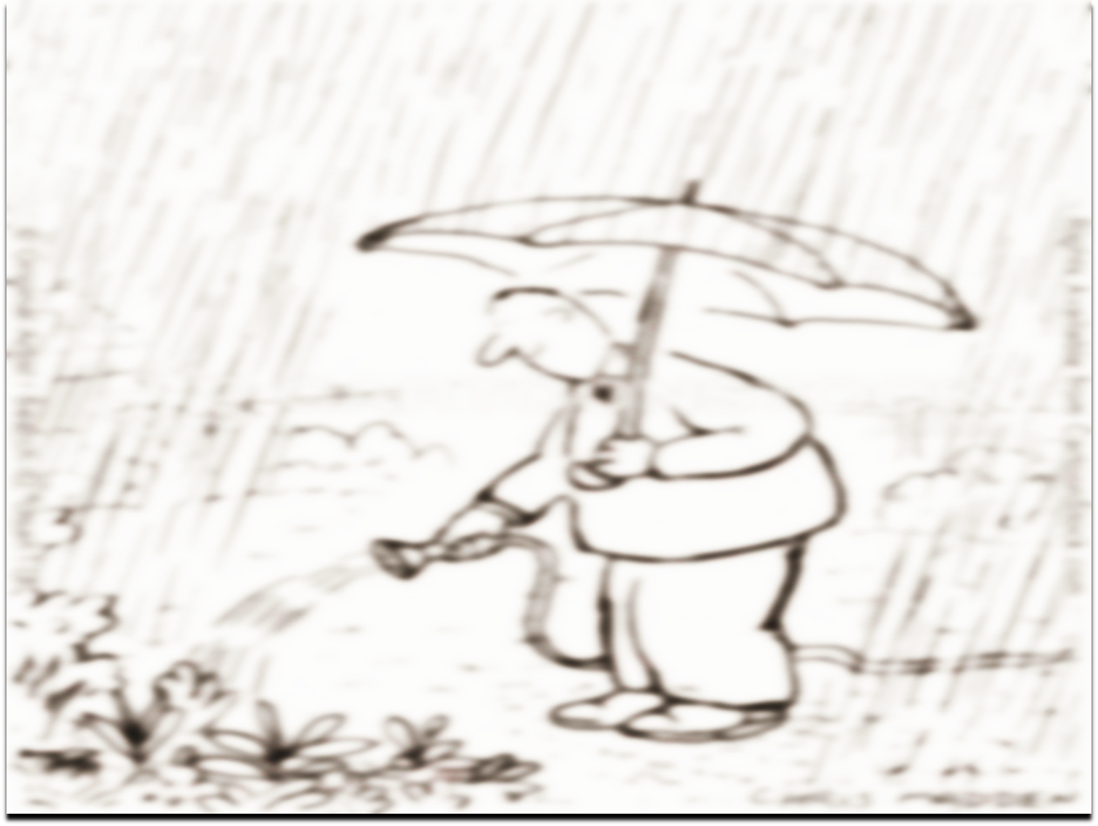
WHY?
No remote Data Acquisition System in the present world is perfect until it remains effective and lasts for a pre-determined amount of time. The proposed Low Power Data Acquisition system proves to be advantageous in both the degrees.

Slide 4

BLOCK DIAGRAM OVERVIEW
REMOTE
STATION
REMOTE
STATION
BASE
STATION
SERVER
REMOTE
STATION
GPRS
REMOTE
STATION
REMOTE
STATION

Slide 5
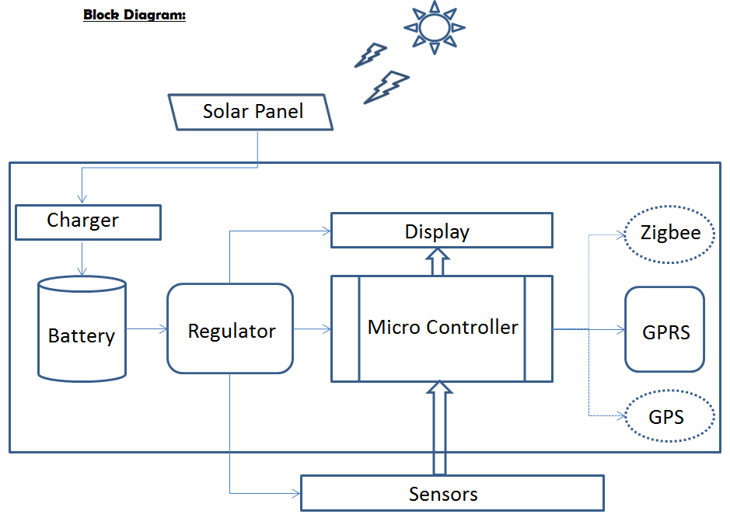
BASE STATION

Slide 6

COMPONENTS EMPLOYED
ARM Cortex M0
SIM900
Relay & Opto-Coupler
16x2 Display
Sensors
Solenoid Valve
Misc.

Slide 7

PROS & CONS
Low power
More advantages
Less disadvantages

Slide 8

Conclusion
Mutual investments are subject to market risk. Please read the offer documents carefully before investing.!

